Slide 1
path planning & ATR
Akshay

Slide 2
Career
Finished college in '22
Learned Computer Vision, Deep Learning Basics
Worked IRAD for 2 years
ATR (SSD Network) : 50% ATR 30% Process Automation 20% Path Planning
Received funding for 1 Senior Scientist
He continued ATR (RTDETR Network)
30% ATR Research 30% Process Automation 40% Path Planning
Notes:
Logos Technologies, recently acquired by Elbit Systems of America (both have relatively small presence)
Automated Target Recognition
Manged SSD End-To-End
Assisted with RTDETR while mainly doing path planning
30% ATR Research 30% Process Automation 40% Path Planning
Layoffs during Acquisition

Slide 3
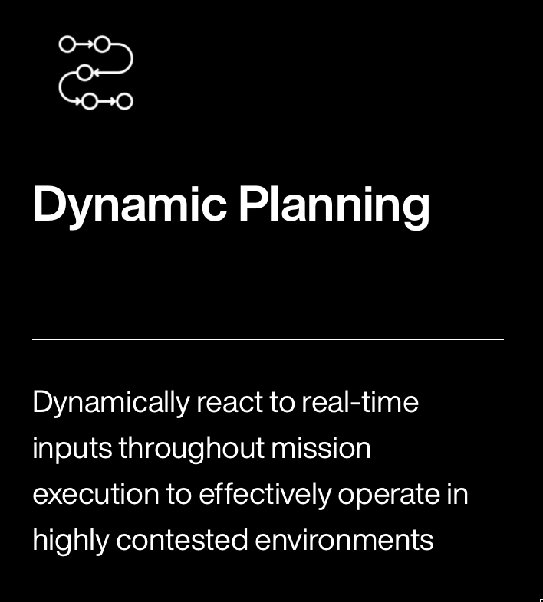
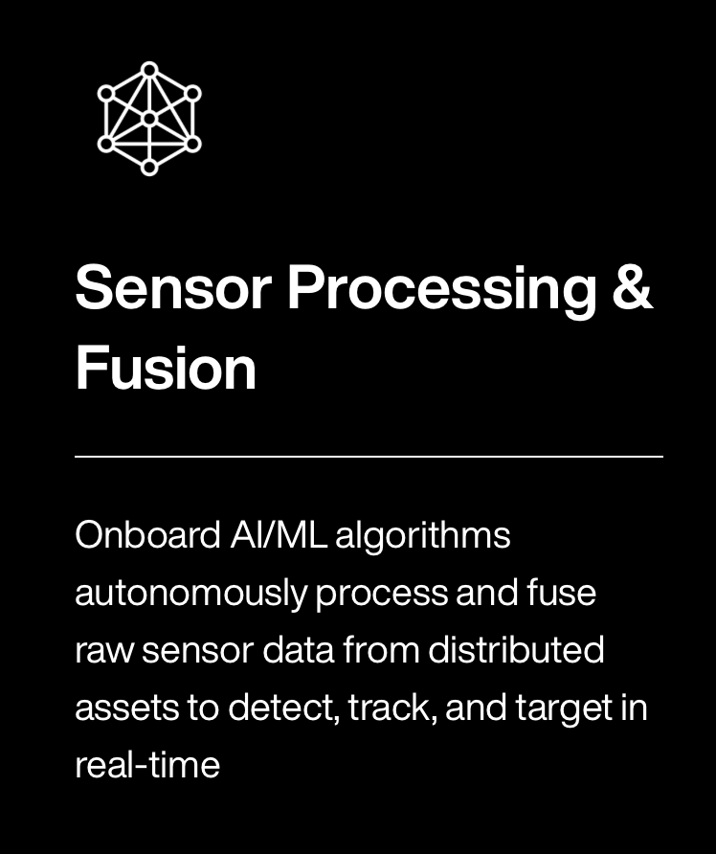

Close the Algorithm Gap against Anduril
Capabilities:
Sensor Fusion
EO Data Pipelines
Fury
Barracuda
Notes:
All of my goals were to close the capabilities gap against anduril
Company had experience with Border Patrol analyzing multiple images at a Time
Attached 360 degree IR camera to hot air balloon in Iraq
good pipelines for most of the main code
Would Anduril advertise missile defense capapbilites?

Slide 4
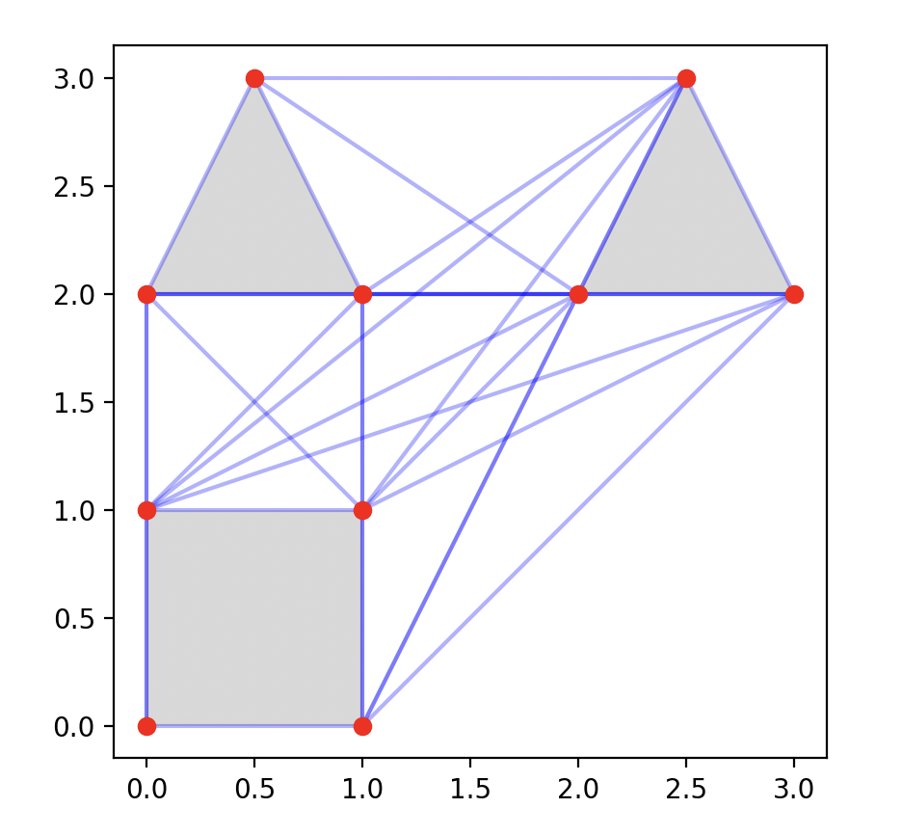
Path Navigation: Visibility Graphs
Obstacle Avoidance
Input:
List of Polygons
Polygon: List of points
Output
Optimal Waypoints
Assumes positional control
True in large spaces
Notes:
Was told to implement A* search for production uses
Preprocesses graph from list of polygons
Approximate circles
1) Not obvious that shortest path is either straight line or touching an obstacle

Slide 5
Implementation Details
Wasn't able to find bugless implementation online
Distance Tables Part 2: Lee's Visibility Graph Algorithm
Raycasting bugs checking whether a point is inside a nonconvex polygon
check must be < O(n)
Visibility graph robot path planning in ROS
Doesn't implement adjacent edges
Fails for non-convex polygons
Implemented naive version in repo
Looking back:
Should have used open-source implementation
Is there a safe O(n) implementation
Worked as intended for production
Notes:
Use open source implementations as often as possible
Failed to observe that the half-open interval checking is also O(n)

Slide 6
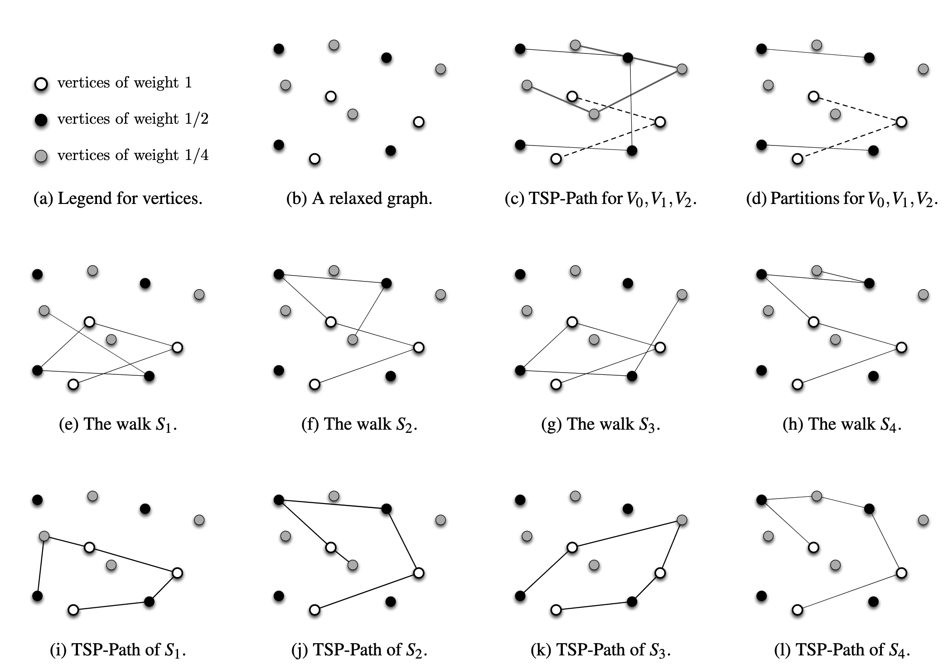
Surveillance: Latency Graphs
General Surveillance Solution
Input:
Euclidean Graph G = (V,E)
Function: Importance(vertex) -> Real
Output:
Infinite Walk
Latency
Importance(node)* time since last visit
Infinite walk
Find a TSP that minimizes sum of latency of all nodes
Notes:
Vertex function
Euclidean:
Distance between edges is a form of the euclidean distance where the triangle inequalilty holds

Slide 7
Results
Python Simulation in Matplotlib with very simple tracker
Made powerpoint for BD
Notes:
Should have made it look way more professional
Should have leaned more into "AI"

Slide 8
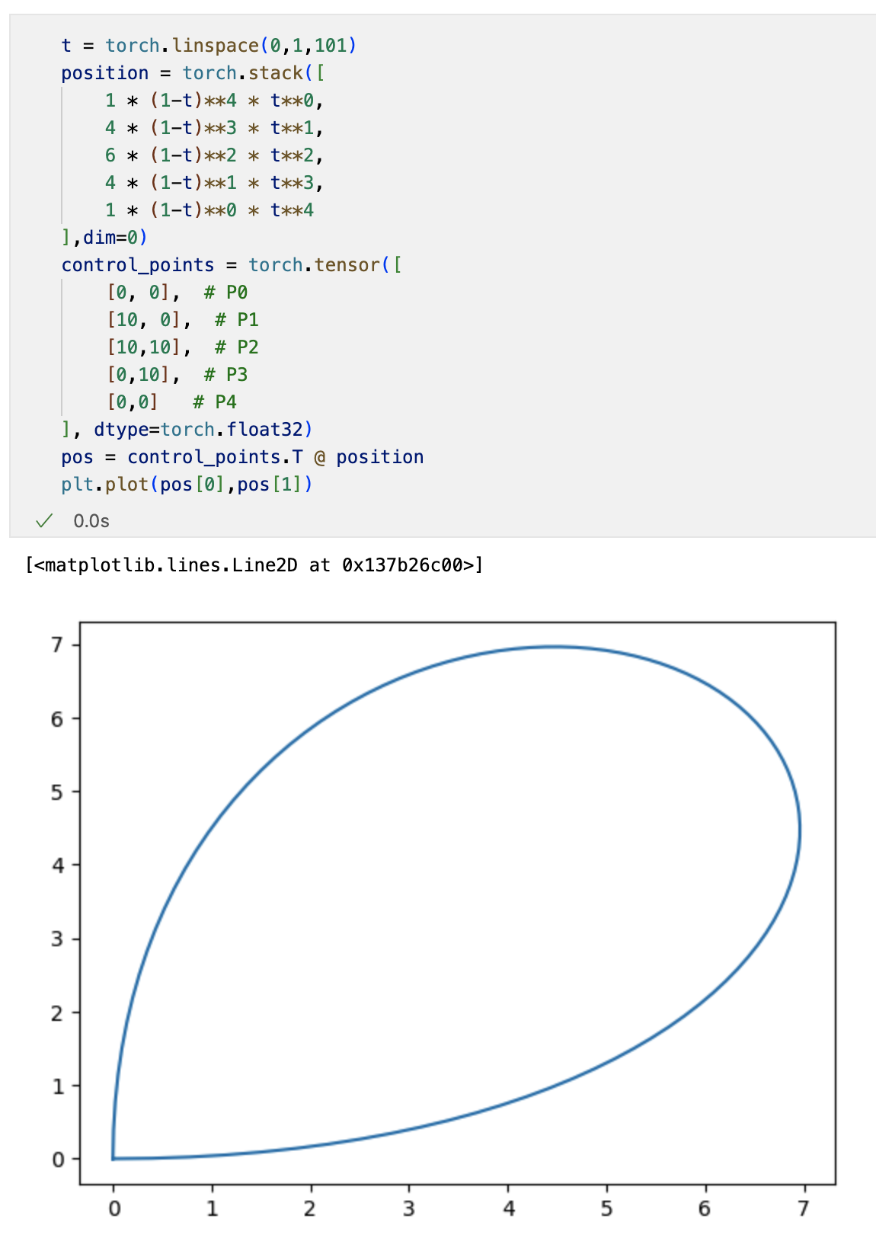
Motion Planning with Bezier Curves
Represent trajectories with bezier curves
Bezier curves use a weighted average of control points to model a unique trajectory
Differential guarantees of configuration
First and last sets position
2nd and 2nd last sets velocity
Used pytorch as a nonlinear optimizer
Ongoing Research:
Developing physics based intuition for loss penalty and constraints
Motion Planning around Obstacles with Convex Optimization
Notes:
Missile guidance system
pytorch does not do branch and bound

Slide 9
Frontier Research
Game Theory on Missile Defense Techniques
How smart should you assume your adversary is?
Radar + Anti-Missile Missiles + IR
Obstacle Avoidance with Motion Control
Mixed Integer NonLinear Optimization: Gurobi Mosek
Notes:
Taught myself the basics of convex optimization during this time
I got mixed up a lot about the differences between each type of optimization

Slide 10
Convex Optimization(Machine Learning)
Extremely similar to nonlinear optimization:
Gradient Descent Methods (Stochastic Gradient Descent)
Interior Point Methods (Nestorov Momentum)
Loss is based off actual minimization goal
no constraints (regularization)

Slide 11
Network Architecture: Object Detection
Modern Object Detectors consist of three parts:
backbone, neck, and head
Recent developments focus on the head:
Best way to map image features to actual objects
SSD was optimized for speed:
Needed to run on NVIDIA Xavier (NVIDIA Orin is the latest)
Quantized to fp16, Used minimal layers
RTDETR optimized for accuracy:
Ran on Orin
Notes:
"Minimal Layers" is a sales gimmick
My Senior Scientist pointed it out upon joining

Slide 12
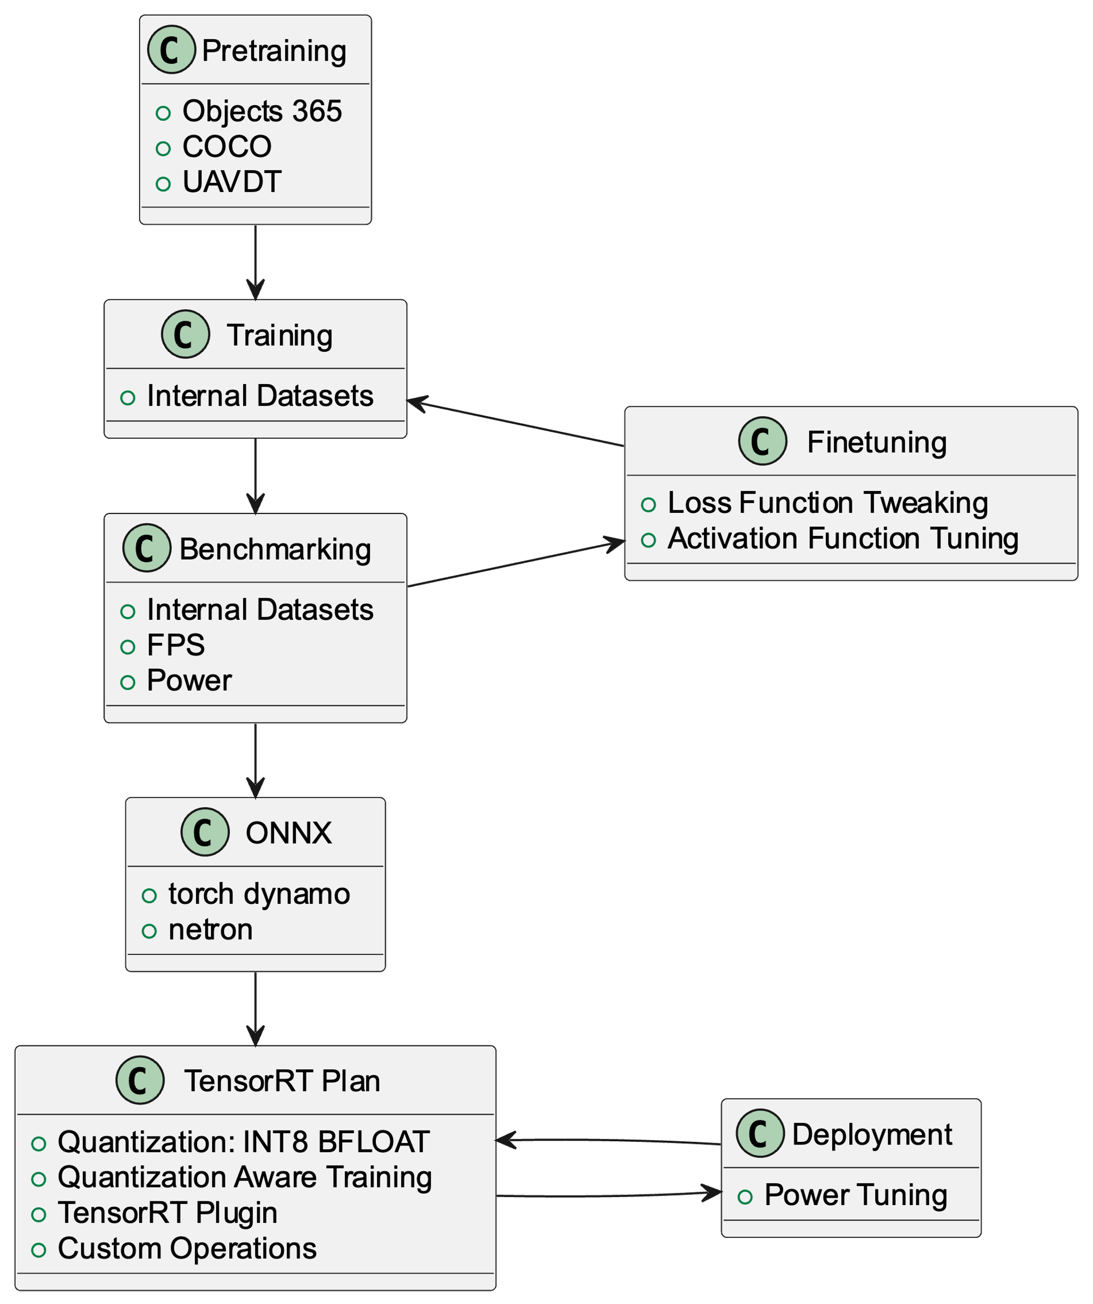
ATR
Data Preparation
Generation
Augmentation
Network Architecture
SSD
RTDETR
Tooling

Slide 13
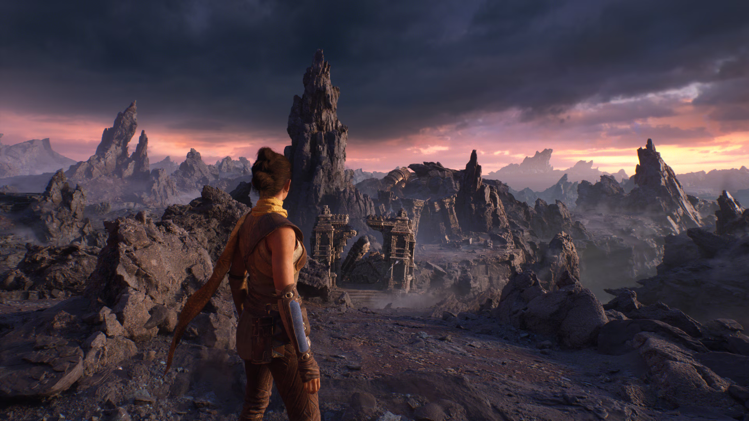

Data Preparation
Data Generation
Unreal Engine
Microsoft Flight Simulator
Data Augmentation
Corrupt Images
Unreal Engine
Notes:
Corrupt images in semantically identical ways
wrote user facing documentation for unreal engine instructions

Slide 14
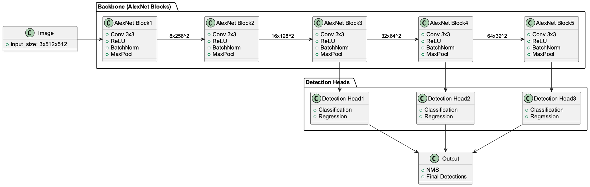
Network Architecture: SSD
SSD
Mature Implementation
Used Simulation Data for first iteration
Included small subsets of labeled real-data for all later iterations
Used SSD until compute requirements were relaxed
Wrote memory management code to run inference inside of event loop
Used TensorRT 8.X with batchedNMSPlugin
Used netron to visualize output

Slide 15
Allocate GPU Memory 1x
Event Loop
If(output ready)
interpret the output
If(input ready)
cuda memcpy
Network

Slide 16
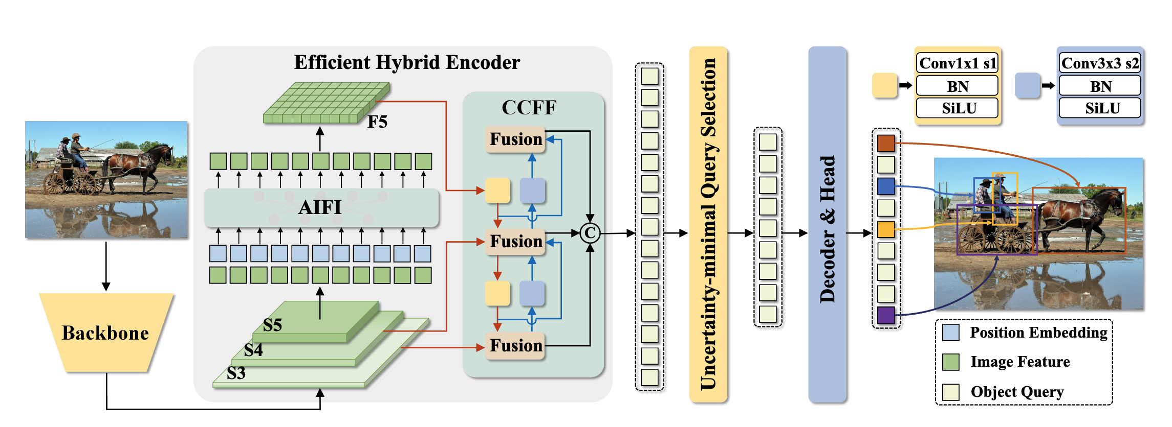
RTDETR
Transformers instead of anchor boxes
Data Engineering
Mature Implementation
DETRs Beat YOLOs on Real-time Object Detection
Notes:
Ran a few training runs
Mainly managed data engineering and data loaders
hierarchial loss functions based on context
shouldn't have spent weeks on the YAML
none of the same licensing issues as ultralytics

Slide 17
Frontier Research
Unsupervised Learning with Autoencoders
Fused Detection and Tracking Pipeline with RNNs
GANs for Data Augmentation

